Slide 1
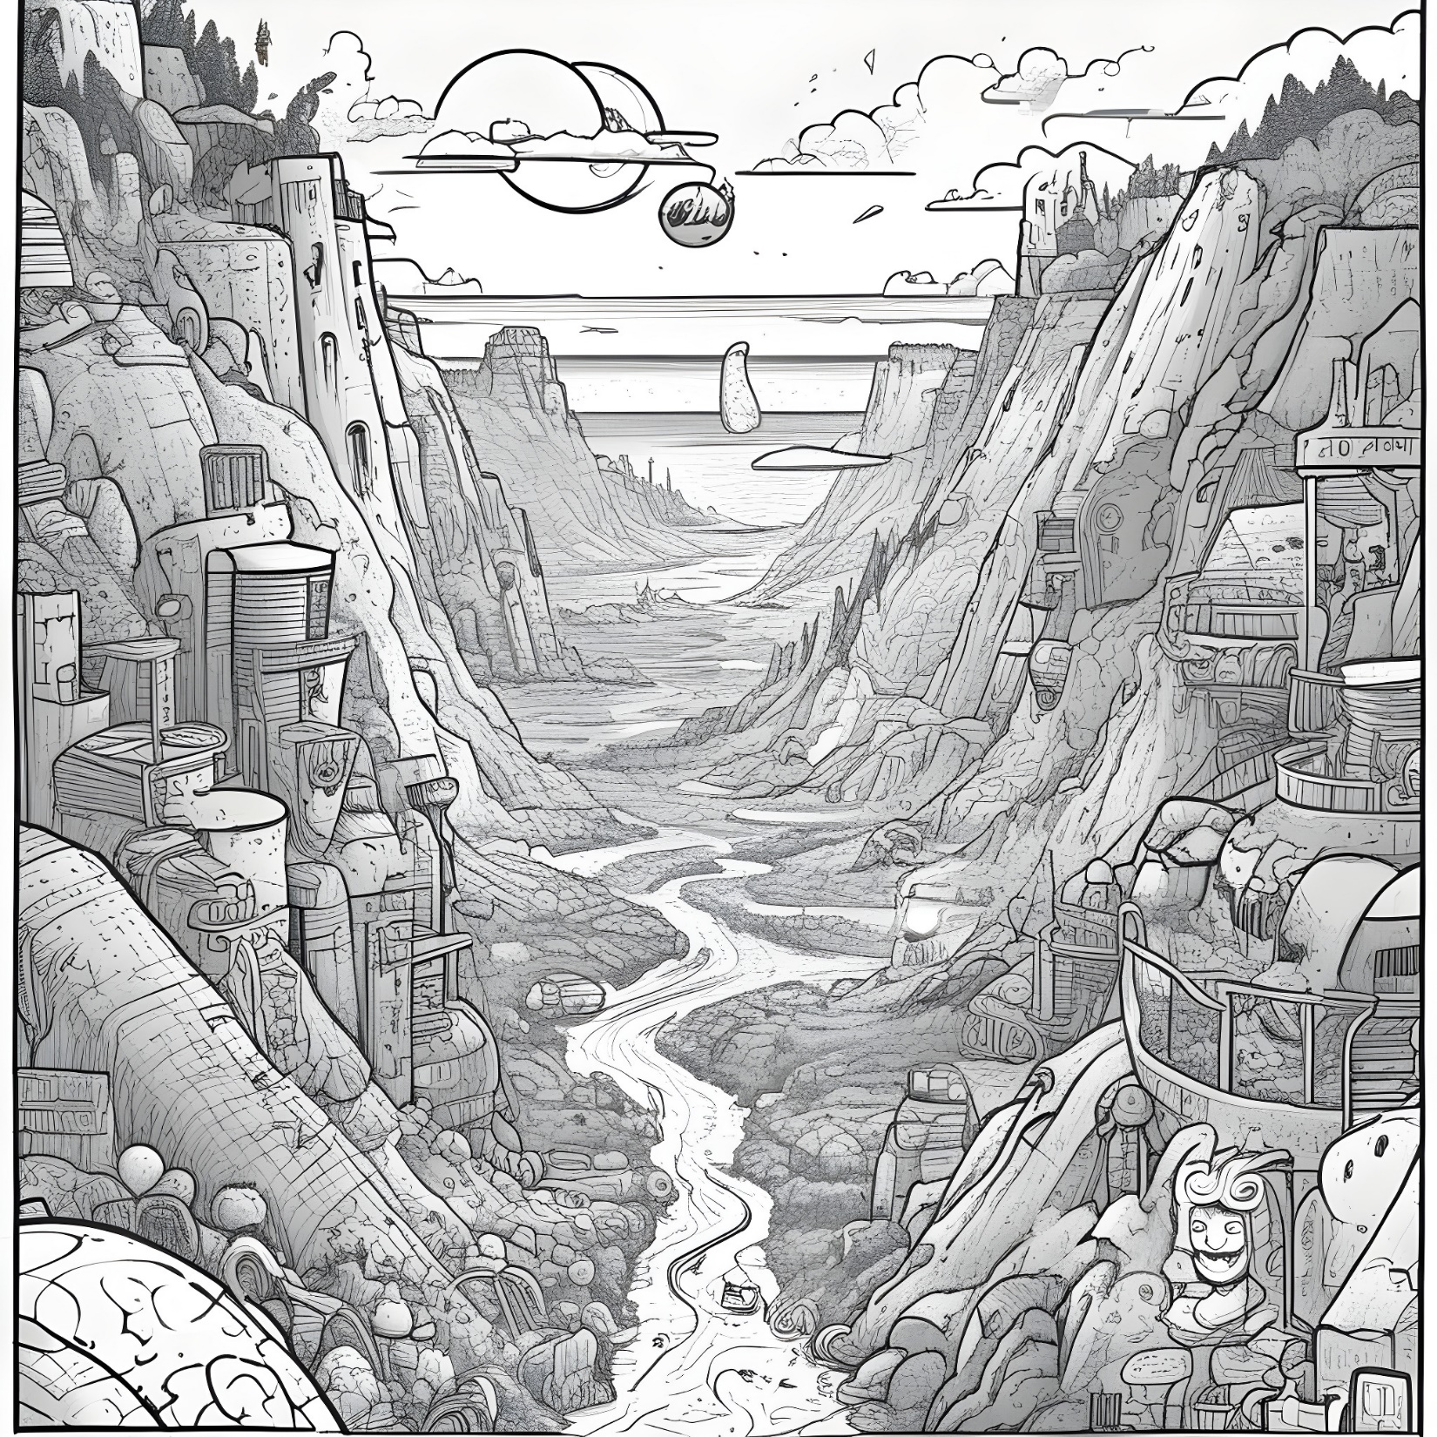

Steller Greed:
An Everwing inspired Game
By Sujal Shrestha

Slide 2
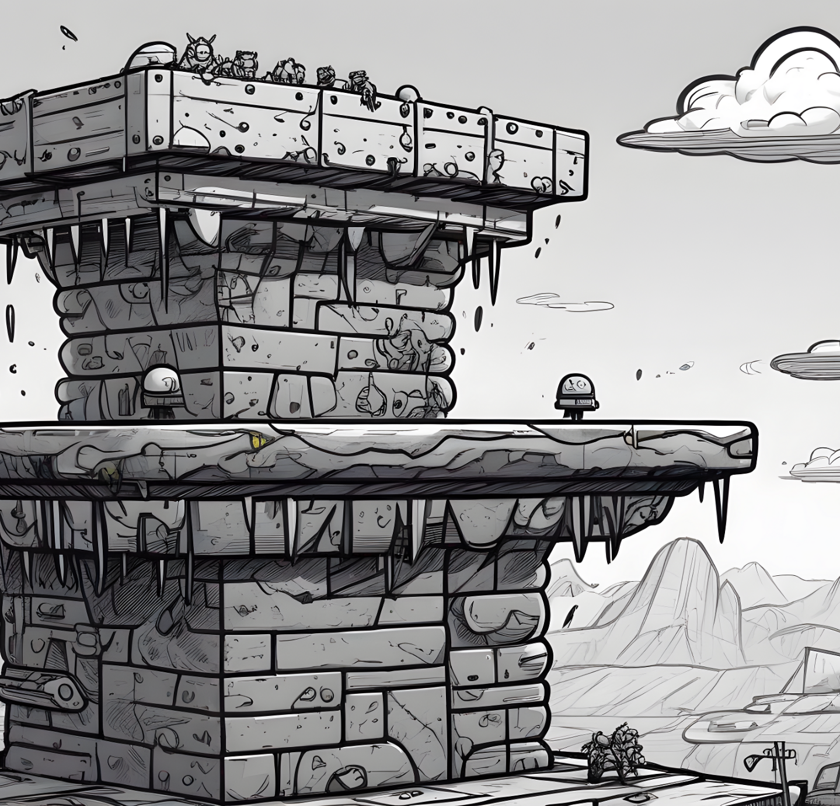
Table of Contents
Languages and Tools Used
Biref overview of EverWing
Our game: Steller Greed
Controls
Rules and Scores
Delployed Link

Slide 3


Brief Overview of EverWing:
EverWing features thrilling side-scrolling aerial combat with guardians and mythical creatures, each having unique abilities.
Engage in multiplayer adventures with friends, strategize, and combine forces to conquer challenges together.
Engage in multiplayer adventures with friends, strategize, and combine forces to conquer challenges together.

Slide 4







Languages and Tools Used
HTML
JavaScript
CSS
VS Code
Google Chrome
Figma

Slide 5
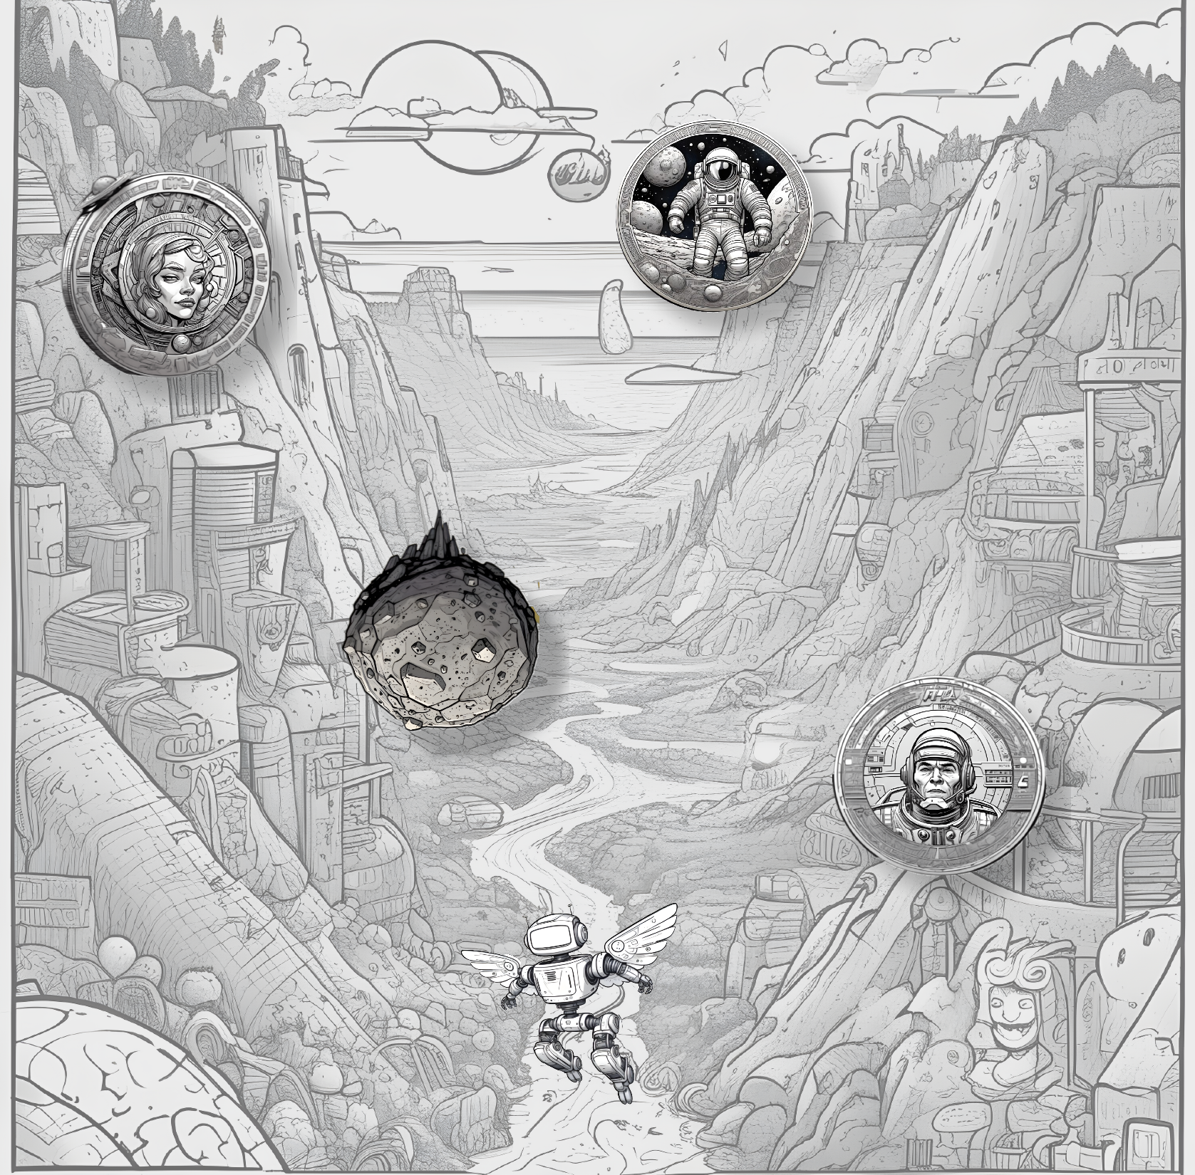
Our game: Steller Greed
Embark on an interstellar adventure with Steller Greed, a mobile game inspired by EverWing.
Make your steller ascend through cosmic heights, avoiding obtacles and satisfying its greed.
Propel your steller to cosmic heights and achieve an out-of-this-world high score.
Steller Greed

Slide 6


Controls:
Click “ “ to make your steller to move towards left
Click “ “ to make your steller to move towards right

Slide 7


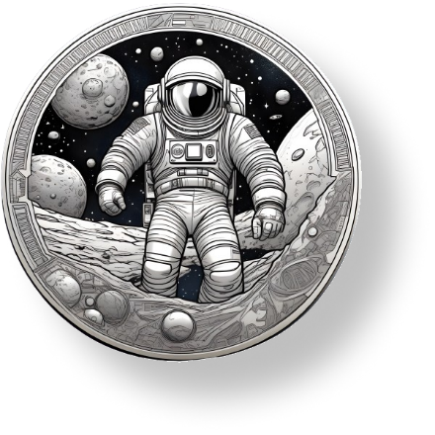

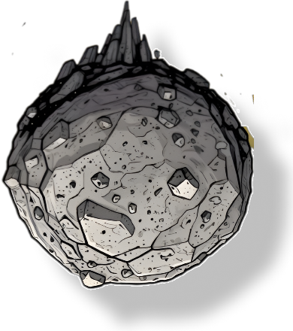
Rules and Scores:
1. Collect the coins to boost your score; the greedier, the better.
3. When your steller can't go on any longer, Its over
2. Avoid These, else your steller gets a hit

Slide 8


ITS THAT SIMPLE!!!!!

Slide 9
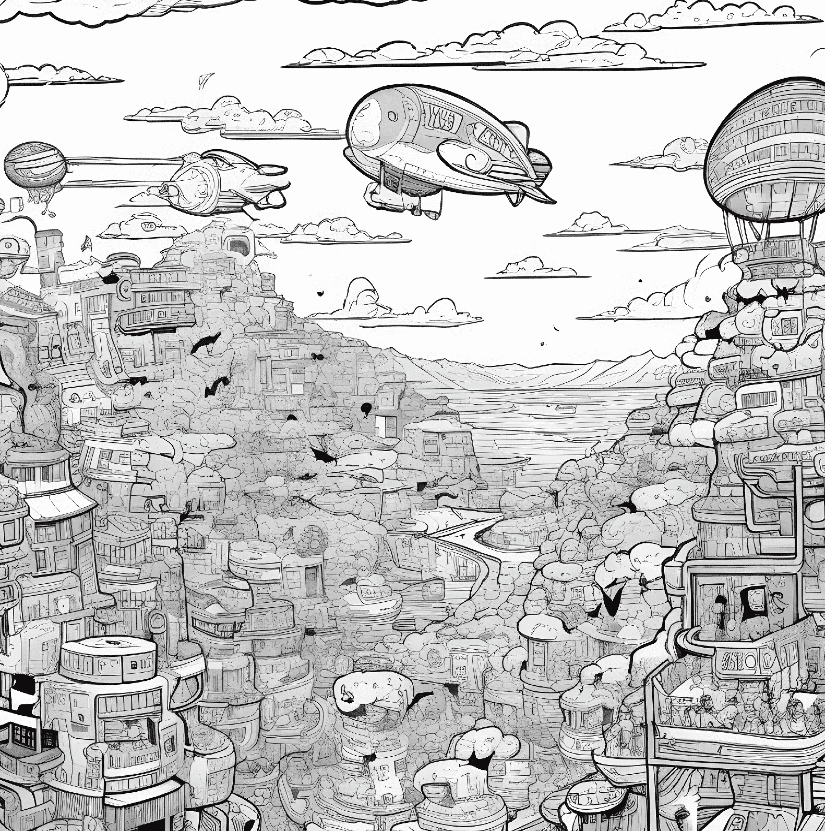

CHECK OUT THE GAME!!!
GitHub Reop:
https://github.com/Sujal-Shresth/stellerGreed
Deployed Link:
https://sujal-shresth.github.io/stellerGreed/
Deployed Link QR Code

Slide 10
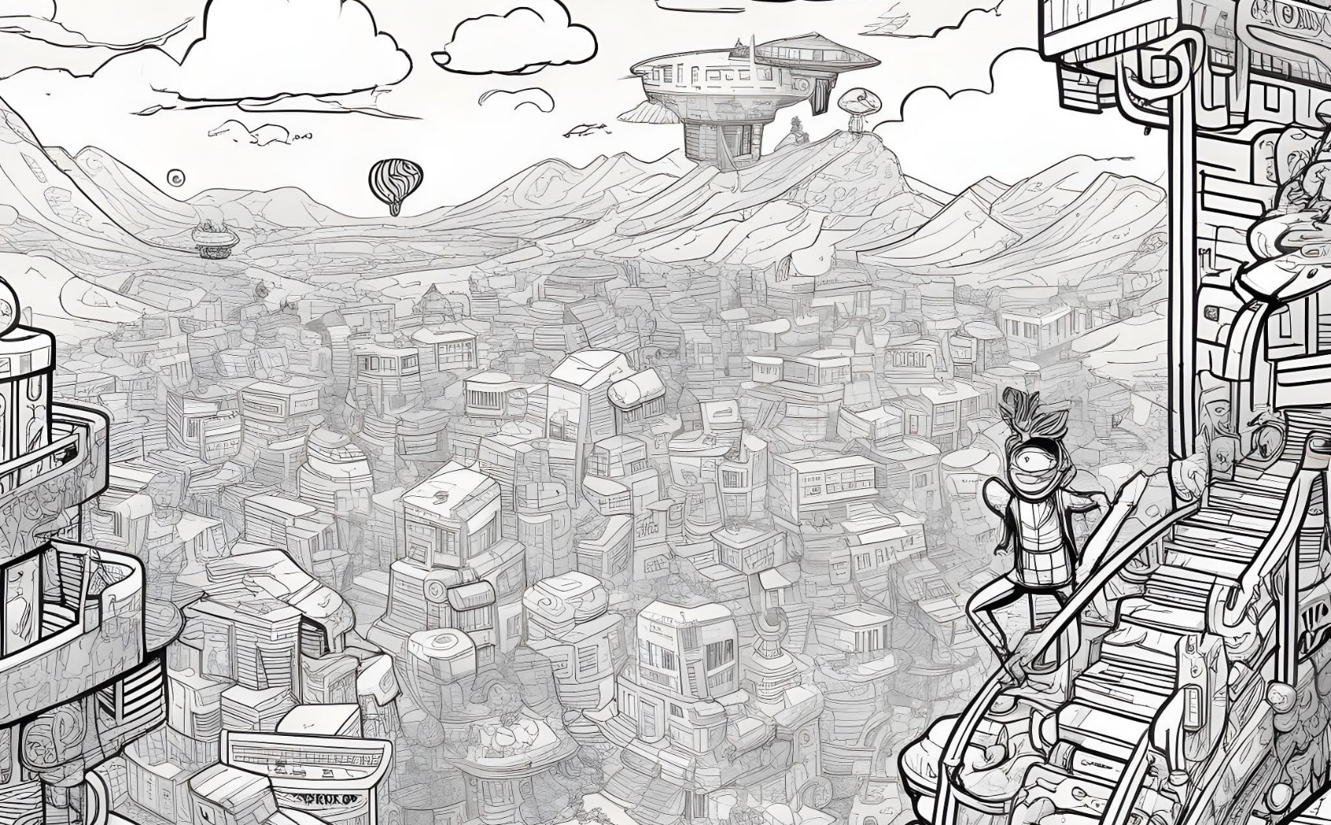
THANK YOU!!

